Slide 1
Ronald Niezen (2009): Transnational Indigenism: Rhetoric of Disillusionment and Hope
Shiann Wahéhshon Whitebean
ANTH 444: International indigenism
Concordia University
September 14, 2016

Slide 2
Central Aspects
Who are Indigenous Peoples? What is transnational Indigenism?
How/why did many marginalized societies begin utilizing the word “Indigenous” as a source of identity?
What makes it possible and worthwhile to press for distinct collective rights, even in opposition to the interests of dominant peoples in control of the powers of the state? [pg. 36]
Critical issues for Indigenous and possibilities for change: health, sustainable development, or environmental protection. (Genocide, ethnocide, etc…)

Slide 3
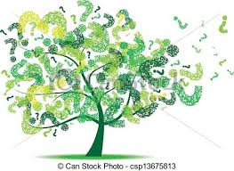
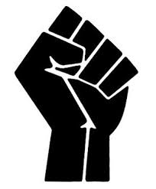
Questions…
→What are some of the general background conditions that made this happen? (What was going on in the world that fueled the Indigenous movement?)
→ How was the term “Indigenous” generally used (for what) before the transnational Indigenous movement?

Slide 4
Birth of Indigenism
The lack of institutional receptiveness to the political integrity of “indigenous populations” changed with the development of human rights and the global movement towards decolonization in latter half of the 20th century. [p. 26]
Global Indigenism - a shift towards reduction of the reach of the nation-state in favour of transnational associations of community identities, based largely upon a globally defined and shared ethos of nature spirituality and environmental responsibility. [p. 41]
Involves transnational networks of peoples and organizations dedicated to protecting those who are the original inhabitants of distinct territories, who now live politically and economically on the margins of nation-states.” [opening statement, p. 17]

Slide 5
“Indigenous”
“Indigenous” term normally applied plants and livestock in a particular region from the seventeenth century until the mid-twentieth century.
Then became used in reference to distinct human group or community with rights of self-determination and ultimately as a legal category of peoples with distinct ways of life on the margins of states.
1953: Report of the International Labour Organization – the term developed a “global currency”
Represented a wider transition towards pluralism from within the Human Rights movement (United Nations), “We the Peoples” of the UN Charter [pg. 27]
Many marginalized societies took up the word “Indigenous” as a source of identity and shaped it into a legal category that is now the focus of numerous human rights, health, and development initiatives in the UN system.

Slide 6
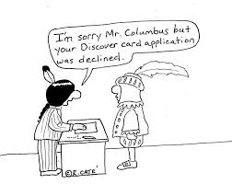
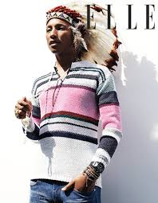
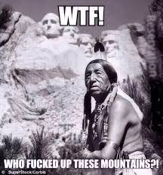
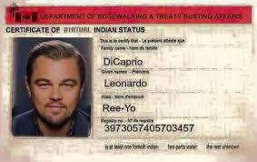
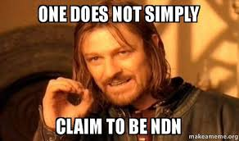

Slide 7
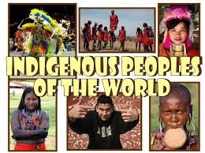
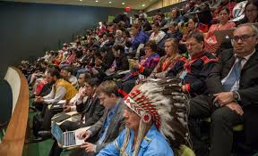
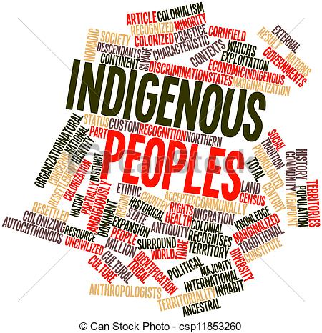
→ Indigenous Peoples are not homogenous but what are some things they have in common?

Slide 8
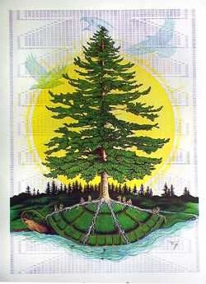
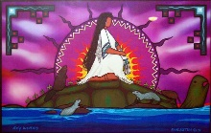
Indigenous Identity & Spiritual Connection with the Land
In the Kanien’kéhá:ka Nation we view the Earth as our Mother and the mother of all living things.

Slide 9
Environment/Land, Deskaheh, Africa
Africa
Environment/Land
Deskaheh
Many Countries claim that they do not have Indigenous peoples
Africa is unique (compared to Indigenous in the North), almost all can reasonably claim Indigenous status [pg.33]
Central concern is exclusion from services of the state and obstacles to subsistence pursuits.
Stewardship/Environmental protection
Sustainable development
Holistic, scientific traditional knowledge
Biopiracy
UNESCO: TEK, TIK, TK
Land claims
Territory
Consistent efforts over time by conquered or colonized peoples, struggling with the state.
Petitioning monarchs
Deskaheh, pursuing grievances through legal processes
Land Claims

Slide 10
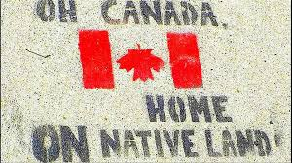
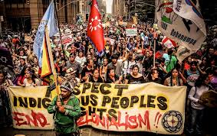
What is “Canada”? Where did the word originate?

Slide 11
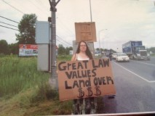
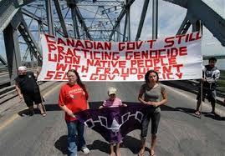
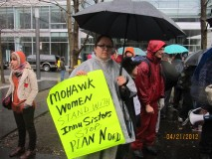
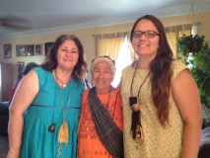
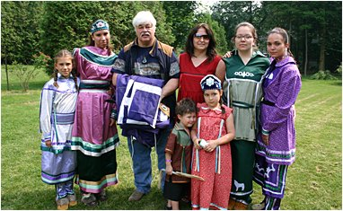
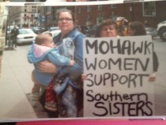
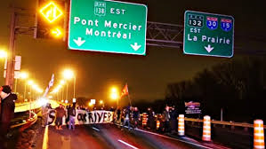
Indigenous Resistance to Globalization

Slide 12
Impact of the Indigenous Movement
UNDRIP
Exercising/affirming identity
Many individuals, groups, nations making claims of indigenous identity (legitimate and illegitimate)
Slow-paced progress, information gathering
Rhetoric of disillusionment, recognition of Indigenous peoples as subjects of rights has far outpaced practical action upon those rights.
Worldwide decline in the legitimacy of state-sponsored policies of assimilation [pg. 28]
Autonomy/Self-Determination
Introduced a new speech genre, a language of collective self-awareness and strivings towards freedom, to the discourse of human rights. [pg. 31]
Global Visibility, Indigeneity is a global identity

Slide 13
Creates new conditions for exclusivity, political polarization, and the grown of racism
What is the subject of recent news stories in Quebec that feature images like the one below?
Central paradox: flux and uncertainty have become inducements to collective self-images of permanence and timelessness…contributed to the rise of distinct socio-political entities with formal membership and sharper cultural boundaries. [p. 21]

Slide 14
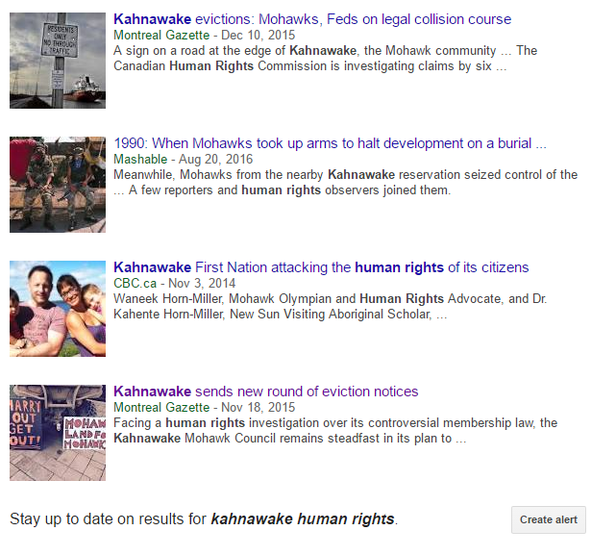
Meanwhile, in Kahnawà:ke…

Slide 15
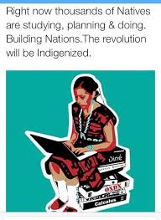
The criteria for leadership and community survival in indigenous societies are very different today…An Indigenous political structure steeped in literacy, bureaucracy, information technology, media relations, and law is gaining importance over long established forms of leadership based on oral knowledge, environmental experience, and the politics of traditional authority.

Slide 16
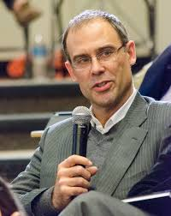
Conclusion…
In the realm of transnational activism, indigenous peoples have come to represent much more than the rights of indigenous peoples. [p. 39]
Cultural & Political reawakening, collective self-awareness and strivings towards freedom. Language of cultural identity is a tool of liberation [pp. 31-32]
Shift of view from public policy & immediate goals of transnational activism to a perspective that considers new dynamics in the politics of identity and processes of self-representation.
Not everything is riding on the standard-setting projects of global governance but what pathways are there towards articulation and redress of collective grievances? (Alternative tools of recognition, rights, and political leverage) [pp.42-43]

